Slide 1

Encopresis:
Also known as Fecal Soiling or
Overflow Incontinence
Often Associated with Acquired Megacolon
Ann Stillwater, RN, CSN, M. Ed.
Harrisburg, Pennsylvania
Notes:
This condition is known by several names, which may add to the lack of awareness. A school nurse since 1993, have seen many cases in a wide variety of schools.

Slide 2
Why Learn About Encopresis?
Understand the condition
Refer more quickly to the nurse for speedy care
Better able to comply with provider orders
Only 40% of sufferers seek medical care (Coehlo, 2011)
Notes:
While we are not doctors and cannot diagnose, but family/teacher may think this is a behavior issue and not realize it’s a medical problem. Also, you may have a family member or friend with this condition.

Slide 3

Early signs
If student has frequent smell of BM that does not dissipate with airflow, consider this diagnosis.
Contact school nurse or send to school nurse.
Encopresis is defecation where not supposed to. Over 90% of cases are from chronic constipation. (Coelho, 2011).
Notes:
Frequent strong BM smell, denial of problems. May be one of best-behaved students

Slide 4
Additional factors
Previously potty-trained for BM’s for at least 6 months.
May be a congenital condition such as Hirshsprung’s or tethered cord.
Experienced health care provider needs to evaluate
Often accompanied by urination problems as well.
Notes:
Per Dr. Punit Jhaveri’s research: Presentations may also include urinary issues
29% of fecal incontinent patient were also urinary incontinent
34% with bedwetting
33% of girls with a UTI, 3% of boys

Slide 5
Possible “withholding” behavior as a toddler
Resisted toilet training for BM
Wanted diaper or pull-up on to have BM
Stood, with tension in body
Held on to table or wall
May have passed stool only in bathtub, when relaxed.
Notes:
When parents are consulted, we often discover a hx of problems in potty-training. This may set the stage for constipation and encopresis as the child grows older.

Slide 6
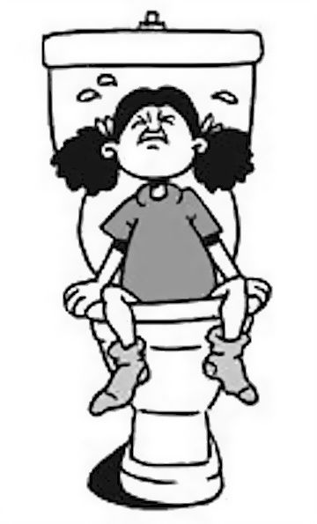
Constipation
Tends toward constipation
Large BM may clog toilet (Garman & Fica, 2012)
Parents may not monitor BM’s, so may not know
Notes:
Child may not know what is normal. And if parent tends towards constipation also, they may not know WNL either. And this has all been background information. In about 1% of children, constipation may slip over into . . .

Slide 7
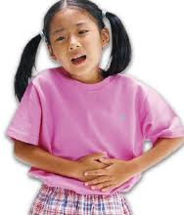
Painful Cycle of Defecation
Constipated, so having BM hurts
Holds it in
BM becomes dryer, harder, bigger
More painful
More determined to hold it in
Notes:
It sounds funny, but it really is painful.

Slide 8
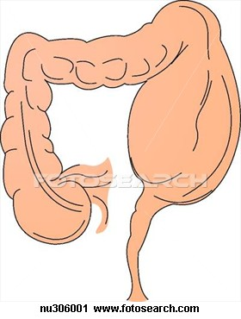
Colon is stretched
No longer has normal sensation due to increased diameter of colon.
Can’t feel when needs to move bowels
Notes:
This illustration is of an aganglionic colon, a congenital condition. If questioned, please point out that the normal child’s rectum would most likely be larger than pictured here, but the rectum can stretch and shrink as needed.

Slide 9

Continues to eat
Semi-liquid BM squeezes around the impaction
Smear of BM in underpants
Stretched colon means altered sensation

Slide 10

Shame and Embarrassment
Shame that cannot hold in BM
Private topic and area of body
May be accused of deliberately defecating

Slide 11

Family Dynamics Strained
Parental fear of “poor parenting” label
Family stress may be causative too
  New sibling
  Parental discord
  These may exacerbate physical problem
Often power struggles develop, related to encopresis
Notes:
Medical problem with pyschosocial components.

Slide 12

See experienced provider
Mistreatment with only counseling or anti-diarrhea meds from some health care providers
May need referral to a pediatric gastroenterologist

Slide 13
Medical Supervision!
Families may feel they can treat it themselves, but don’t have expertise
In 5-15% there are other factors causing the problem-need professional to check
Strained dynamics-parents & child working together to carry out medical plan starts the healing process and facilitates family harmony

Slide 14
Treatment: clean out colon
Medications-as provider instructs
  Not to be used regularly
  Just for initial clean out
Possibly enemas
  Enemas may be traumatic
  Not used as much as in past

Slide 15
Treatment: on-going medication
Keep bowels loose
Medications, one or more of:
  Polyethylene Glycol (Miralax™)
  Stool softeners
  Bulk-forming laxatives such as Metamucil™

Slide 16

Treatment: diet
Diet
  Increase fiber:
    Whole grains
    Fruits
    Vegetables
  Decrease:
    Refined grains
    Sugars
    Fats

Slide 17
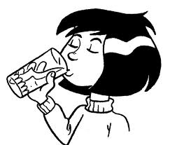


Treatment: Lifestyle
Fluids--increase water
  Softens stool
Exercise helps with stool passage

Slide 18
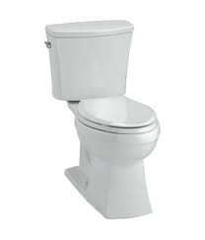
Treatment: Toileting
Regular schedule
Praise/reward BM
Can’t feel, but needs to be regular!
May need to sit on toilet after breakfast
  Ten-fifteen minutes after meal is ideal
  Best in clinic restroom (for monitoring)

Slide 19
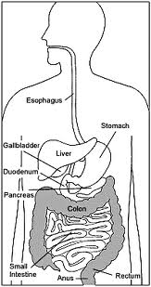
Colon return to close to normal size after 2-12 months
Colon shrinks, sensation returns to normal.

Slide 20
Encopresis can recur
Monitor closely
Should continue high fiber diet, fluids, exercise, perhaps medications
May be prone to constipation even into adulthood

Slide 21

Normalcy
This is a medical condition that needs treatment
Focus on student strengths and accomplishments
Support student and family in treatment
Monitor peer interactions and intervene as needed if teasing or bullying
Notes:
For your own children and Parent teaching, monitor BM’s and if constipation seek professional help to avoid encopresis

Slide 22
References
Coehlo, D. (2011). Encopresis: A Medical and Family Approach. Pediatric Nursing, 37, (3), 107-112.
Garman, K and Ficca, M. (2012). Managing Encopresis in the Elementary School Setting: The School Nurse's Role. The Journal of School Nursing. 28(3), 175-180.
Qureshi, Dr. Muhammad Azim (2013). Personal communication.
Jhaveri, Dr. Punit (2013). Constipation PowerPoint

Slide 23
Dissemination
This PowerPoint may be used for non-profit educational use if proper credit is given to author Ann Stillwater.

Slide 24
Additional Resource
North American Society for Pediatric Gastroenterology, Hepatology and Nutrition
http://www.naspghan.org/user-assets/Documents/pdf/Public%20Education%20Brochures/2011/FECAL%20SOILING%20-ENG%20REV12-10.pdf

Slide 25
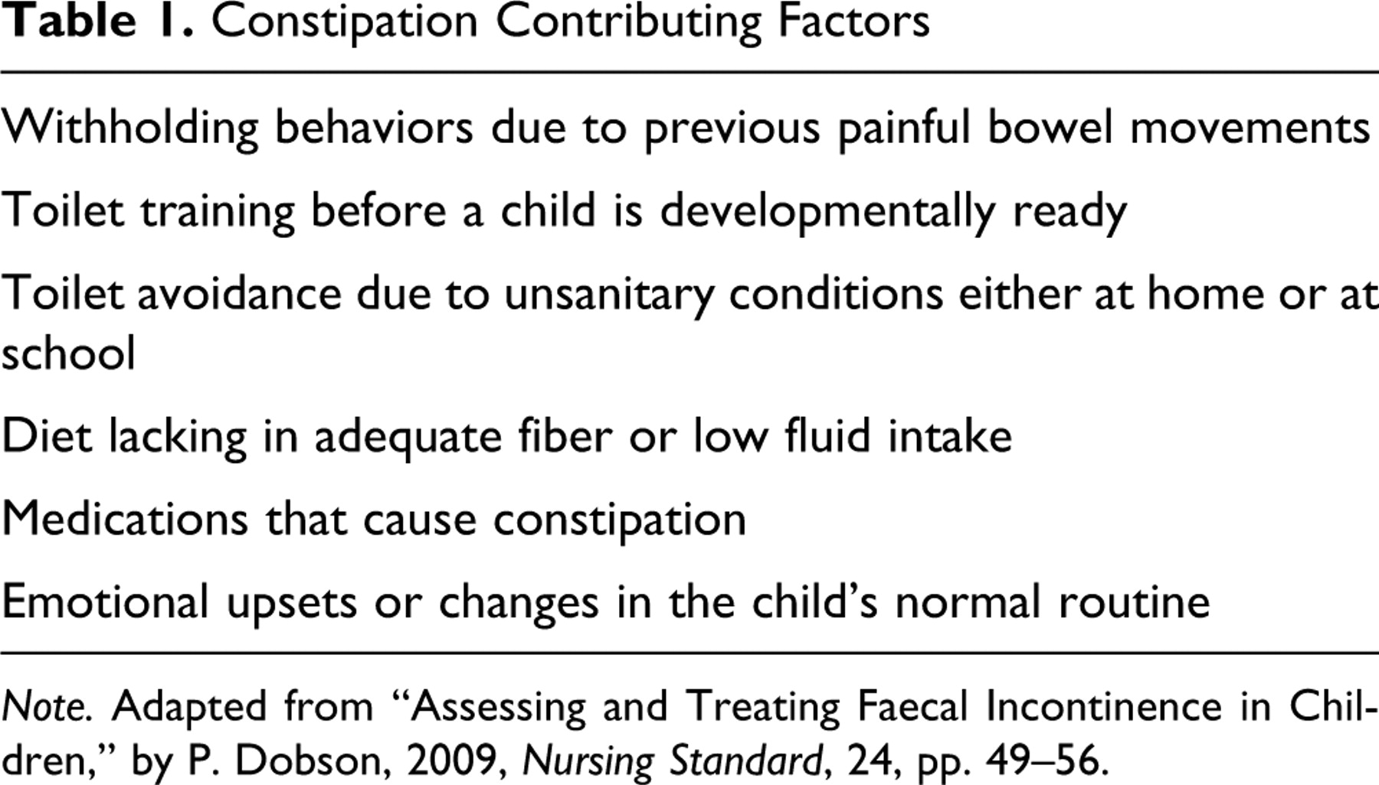

Table 1. Constipation Contributing Factors.
Garman K , and Ficca M The Journal of School Nursing 2011;28:175-180
Copyright © by National Association of School Nurses
Notes:
Constipation Contributing Factors

Slide 26
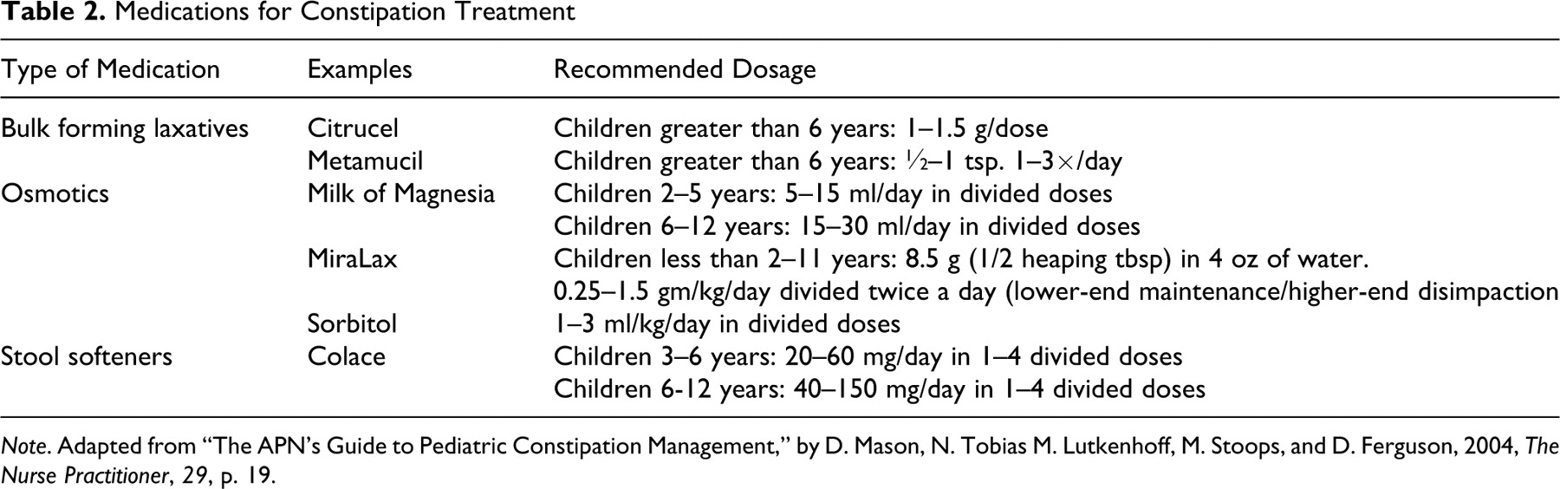
Table 2. Medications for Constipation Treatment.
Garman K , and Ficca M The Journal of School Nursing 2011;28:175-180
Copyright © by National Association of School Nurses
Notes:
Medications for Constipation Treatment

Slide 27
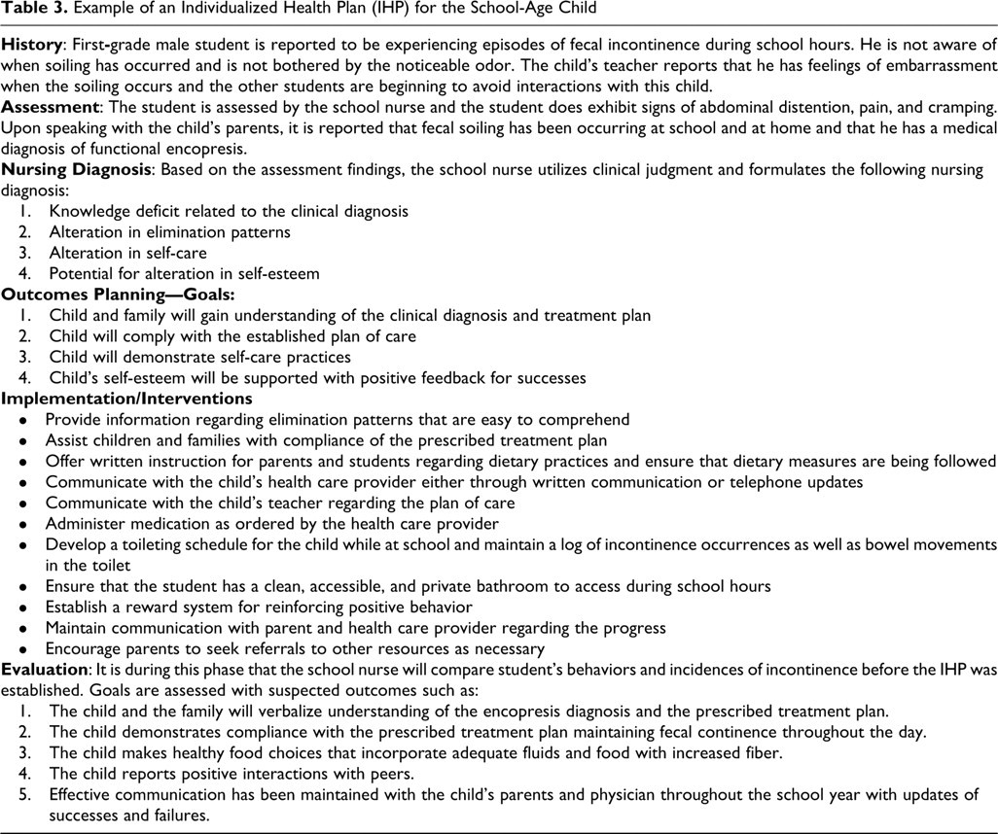
Table 3. Example of an Individualized Health Plan (IHP) for the School-Age Child.
Garman K , and Ficca M The Journal of School Nursing 2011;28:175-180
Copyright © by National Association of School Nurses
Notes:
Example of an Individualized Health Plan (IHP) for the School-Age Child

